Slide 1
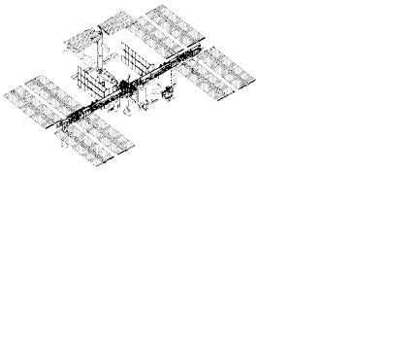
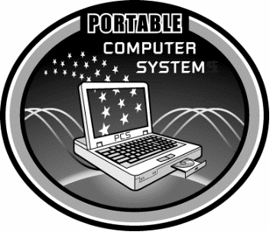
PCS CDDT Overview
10 August 2001
Dave Swartwout / DL2
INTERNATIONAL
SPACE STATION

Slide 2
PCS Displays Philosophy
Provide a graphical, hierarchical, view into the status and conditions of the ISS systems.
  High level module or system overview displays lead down to displays of increasingly levels of detail.
  Lowest level command & status displays provide raw and/or computed telemetry and commanding capability.

Slide 3
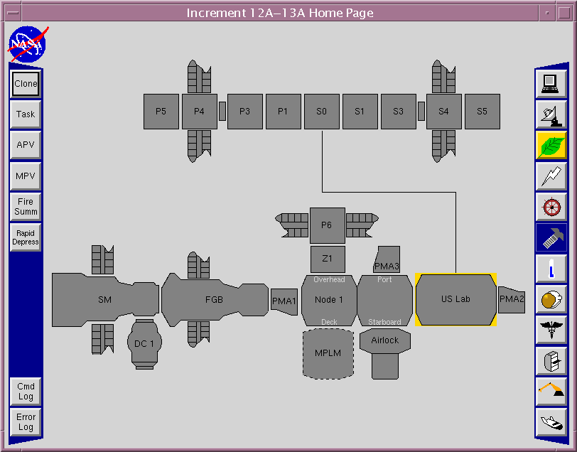
Top Level Home Page

Slide 4
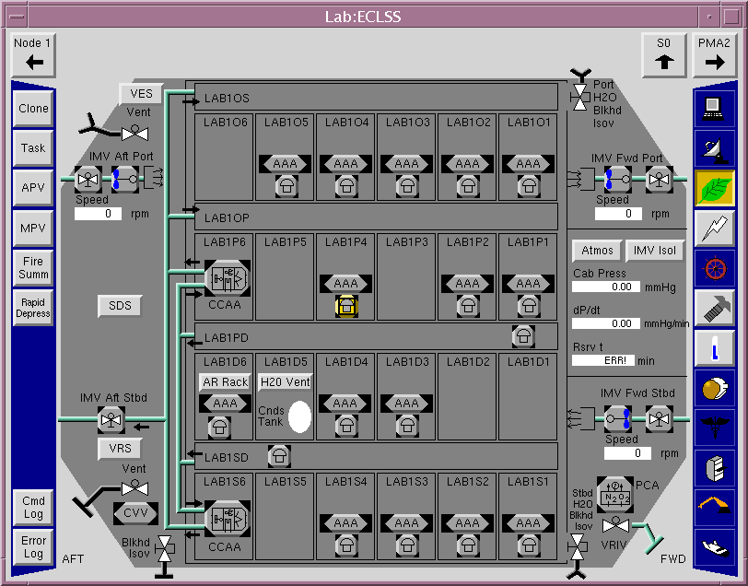
Lab ECLSS System

Slide 5
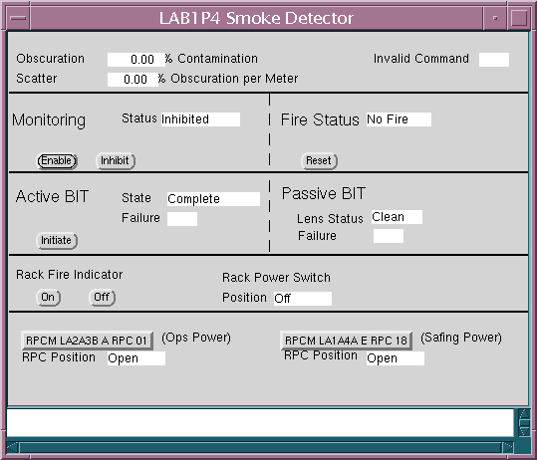
Smoke Detector Command & Telemetry Display

Slide 6
C&W and Alarm Trace
Receive and process ISS C&W messages
  Tabular summary of current C&W messages in the C&W Summary display.
    Allows for user defined sorting and filtering.
  C&W Toolbar informs user of new events.
  Graphical alarm trace shows ORU associated with event message.

Slide 7

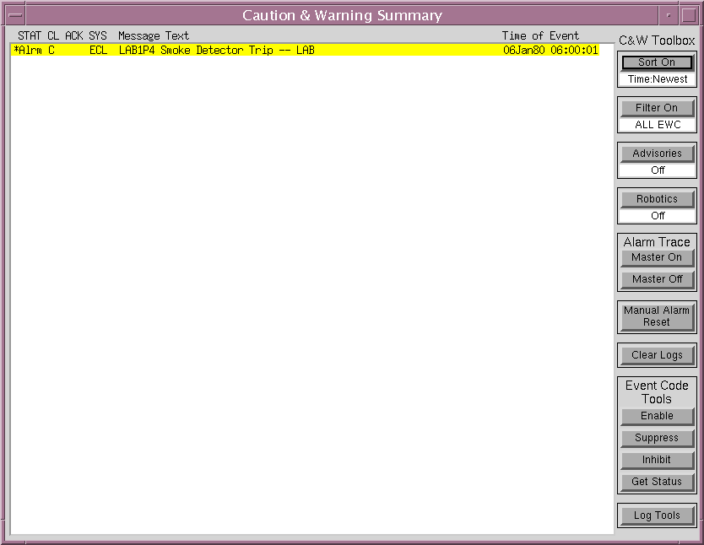
C&W Toolbar and Summary

Slide 8
Graphical Alarm Trace

Slide 9
More Information
PCS Project Web Pages
  http://kria.jsc.nasa.gov/PCS_index.html
PCS Display Evaluation Server
  http://sagan.jsc.nasa.gov
  Requires Windows platform and a plug-in to be downloaded and installed.

